Slide 1
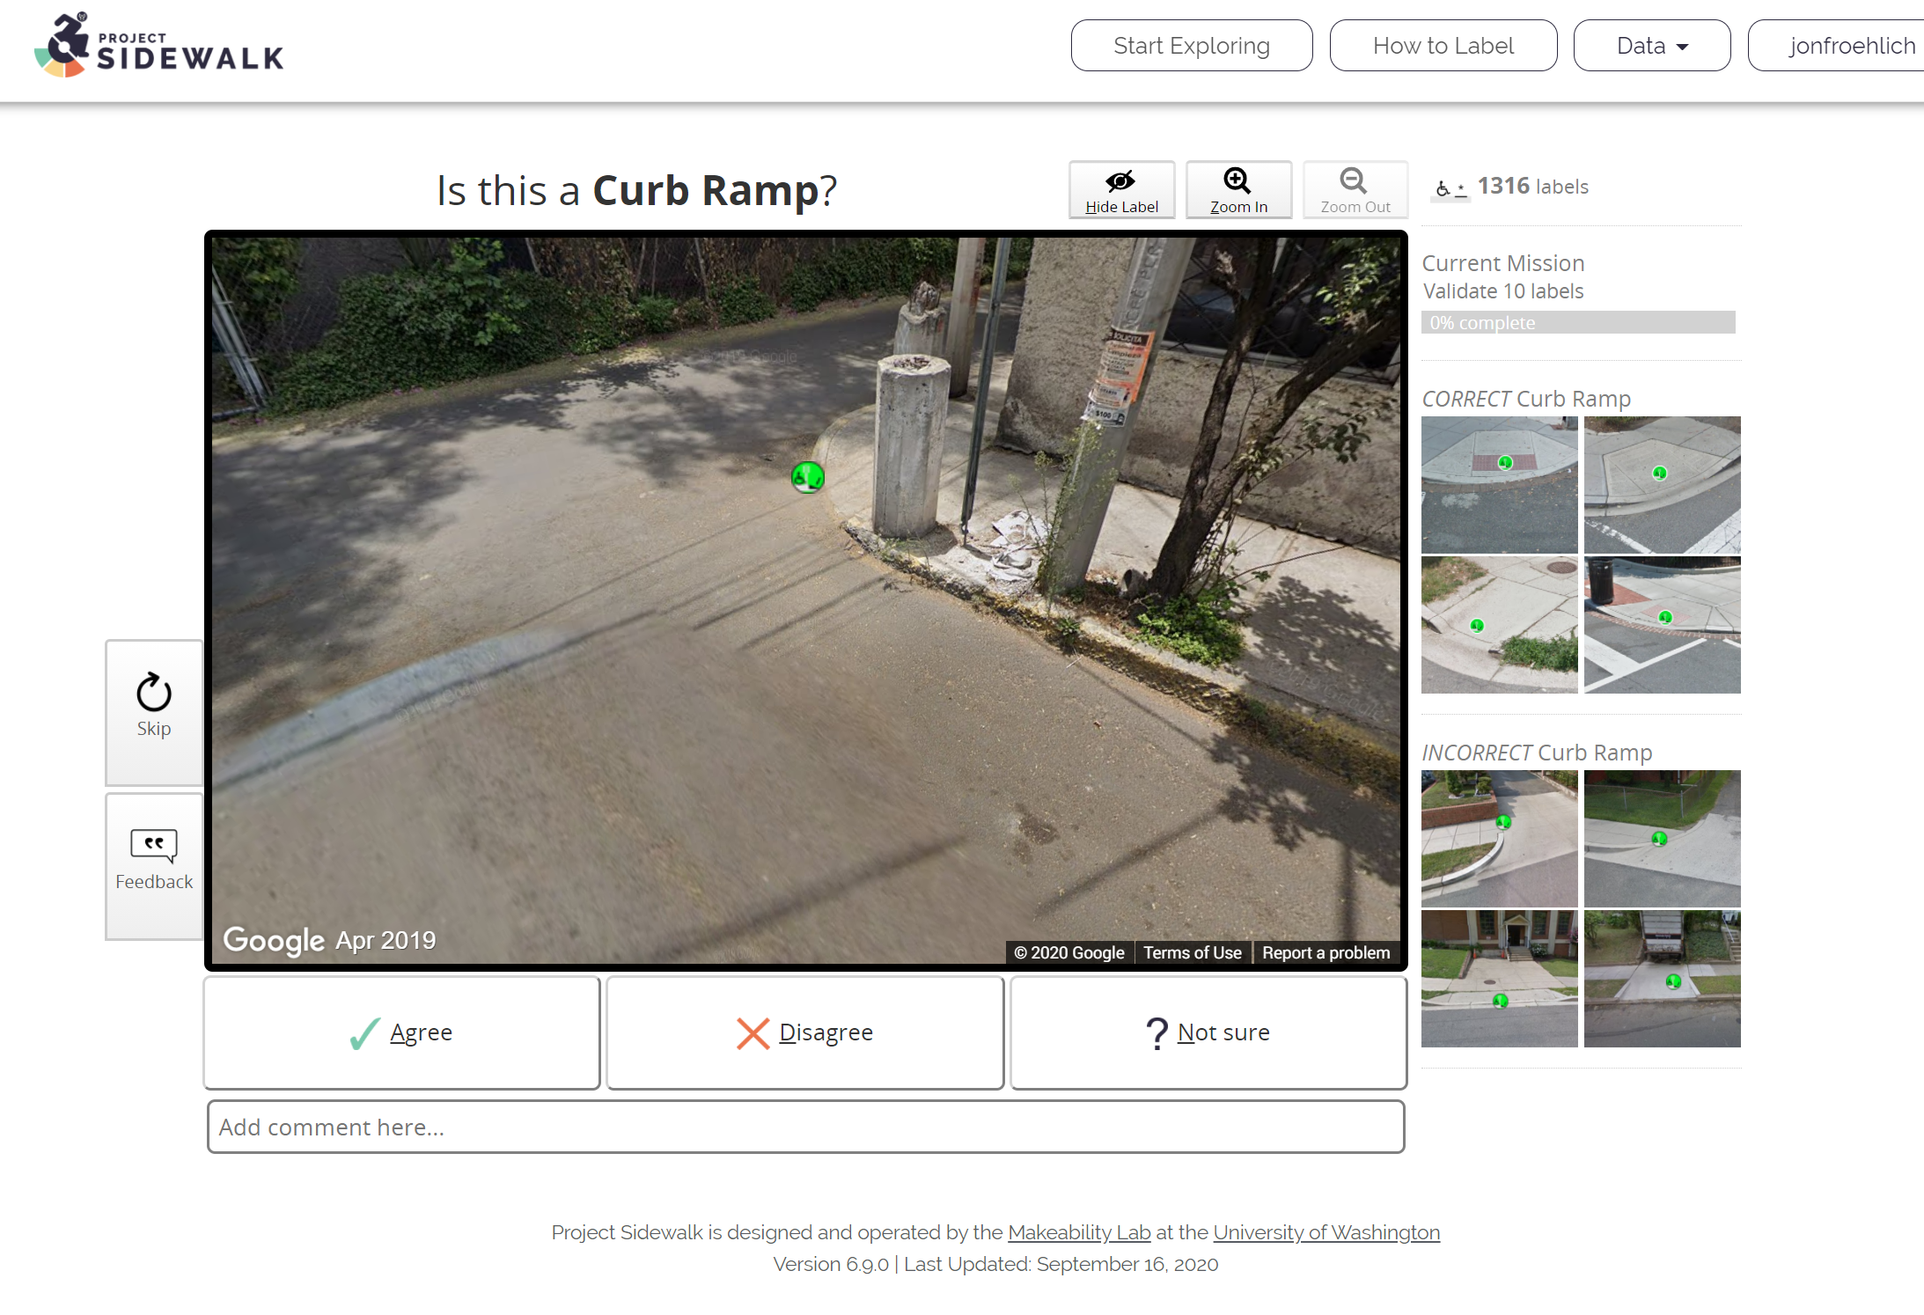
You validate people’s labels
X, Y and Z
Typical validation rates are X, Y, and Z

Slide 2
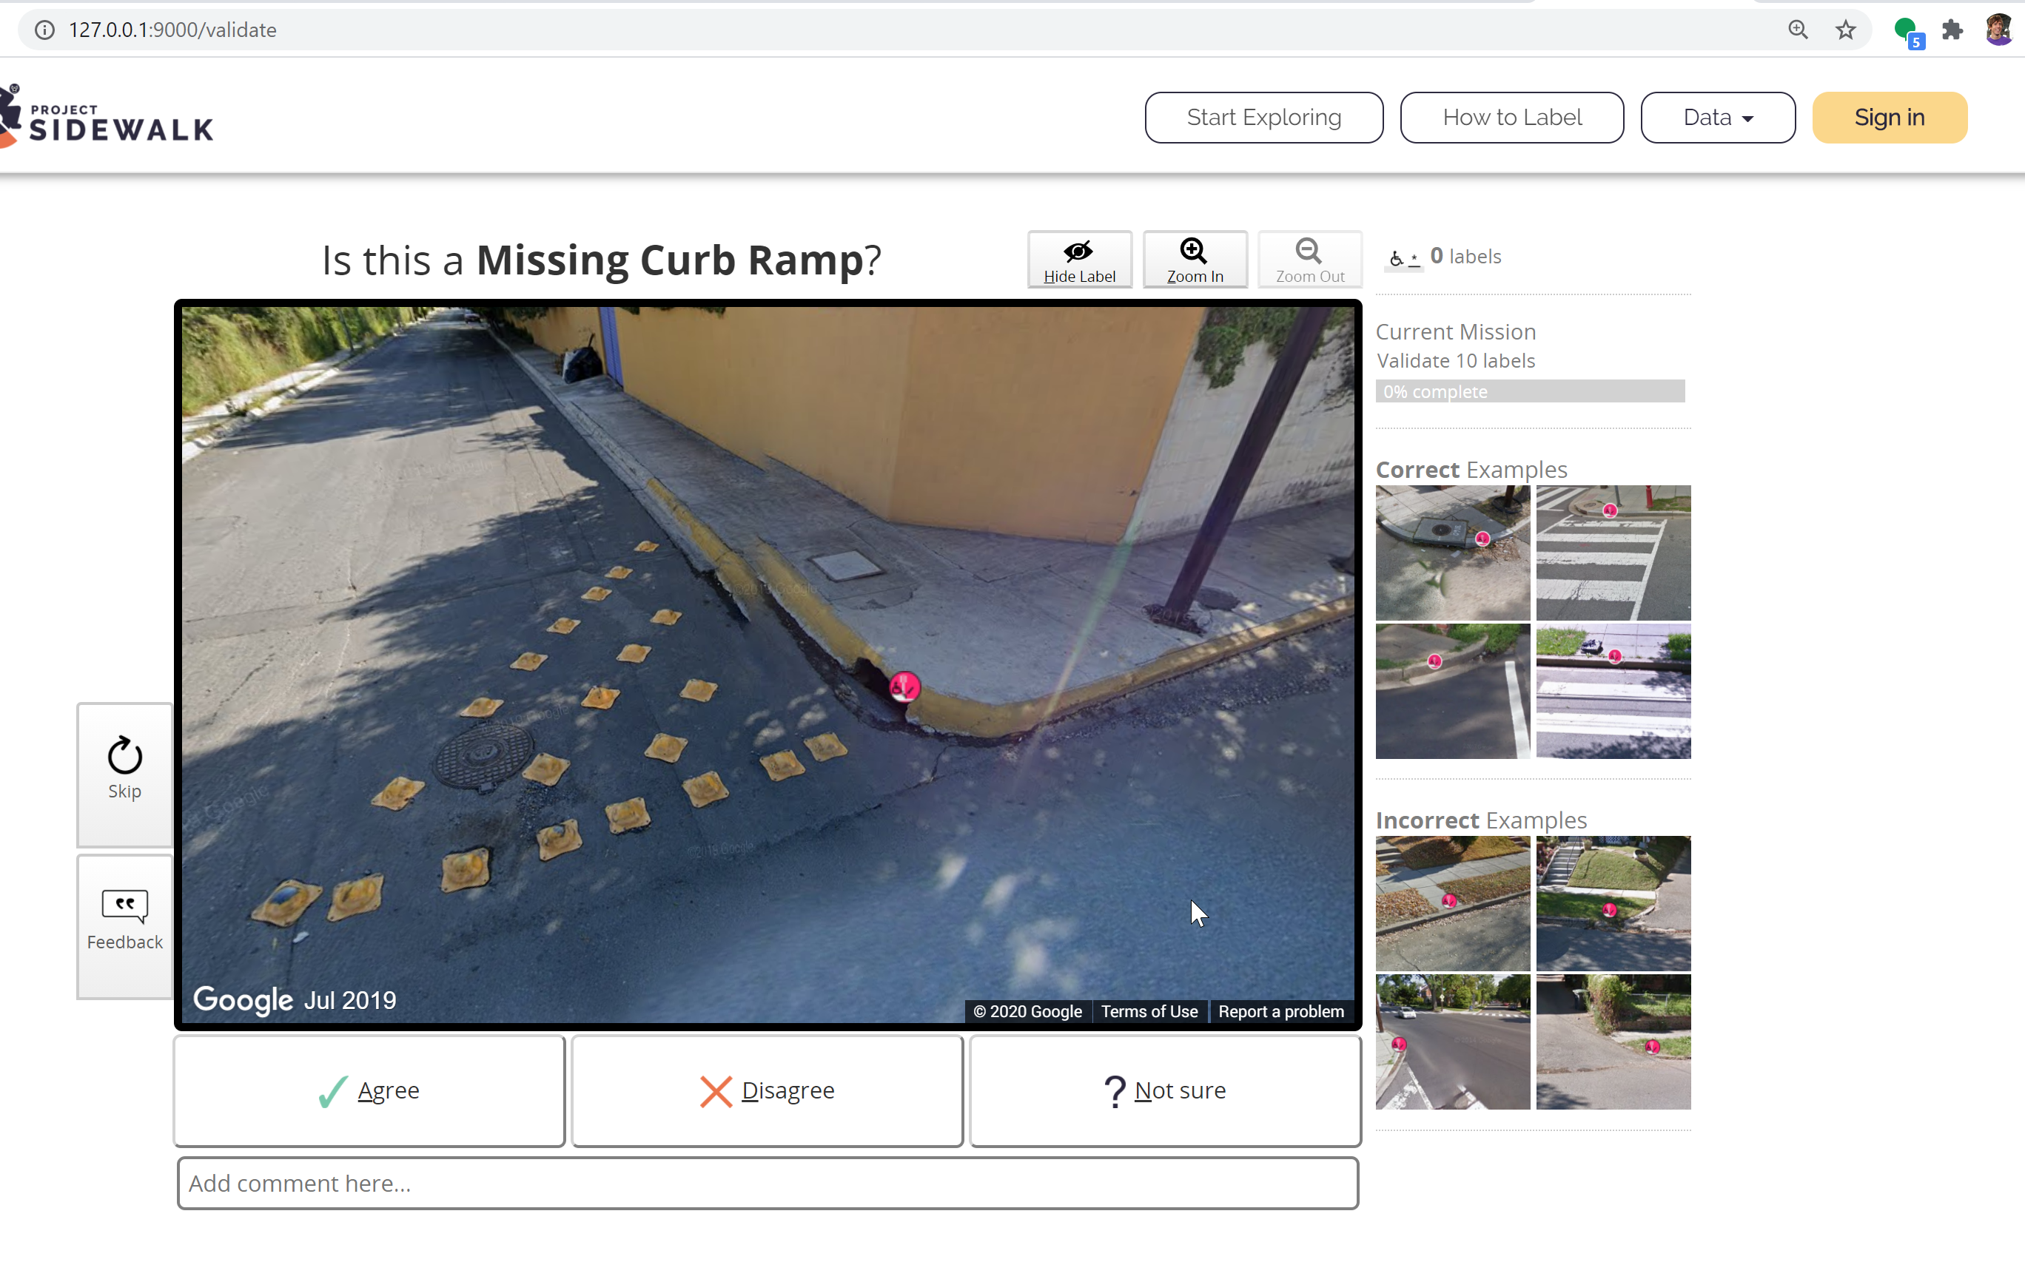

Slide 4
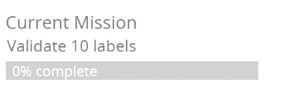
 | Agree | Disagree | Unsure
Your counts | 333 | 125 | 50
Your % | 75% | 15% | 5%
Others’ % | 80% | 5% | 15%

Slide 5
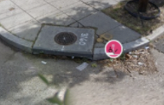
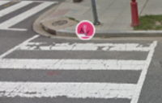
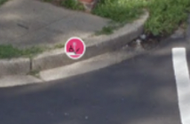
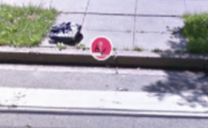
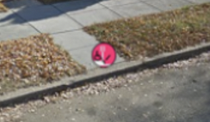
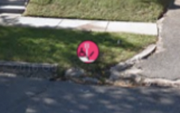

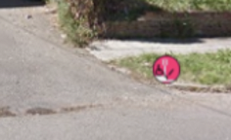
All Labels
Count:
You agree:
Others agree:
498 validations
71%
83%
Missing Curb Ramps
Count:
You agree:
Others agree:
98 validations
75%
85%
Correct Labels
Incorrect Labels

Slide 6
All Labels
498 validations
You agree: 71%
Others’ agree: 83%
Missing Curb Ramps
98 validations
You agree: 75%
Others’ agree: 85%
Correct Labels
Incorrect Labels

Slide 7

All Labels
498 validations
You agree: 71%
Others’ agree: 83%
Your Rank
4th
Missing Curb Ramps
98 validations
You agree: 75%
Others’ agree: 85%
Correct Labels
Incorrect Labels

Slide 8

All Labels
498 validations
You agree: 71%
Others’ agree: 83%
Achievements
Validations Badges
Your Rank
4th
100
500
1K
10K
Correct Labels
Incorrect Labels

Slide 9

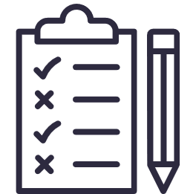
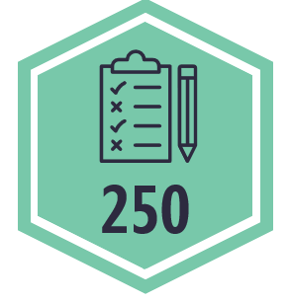
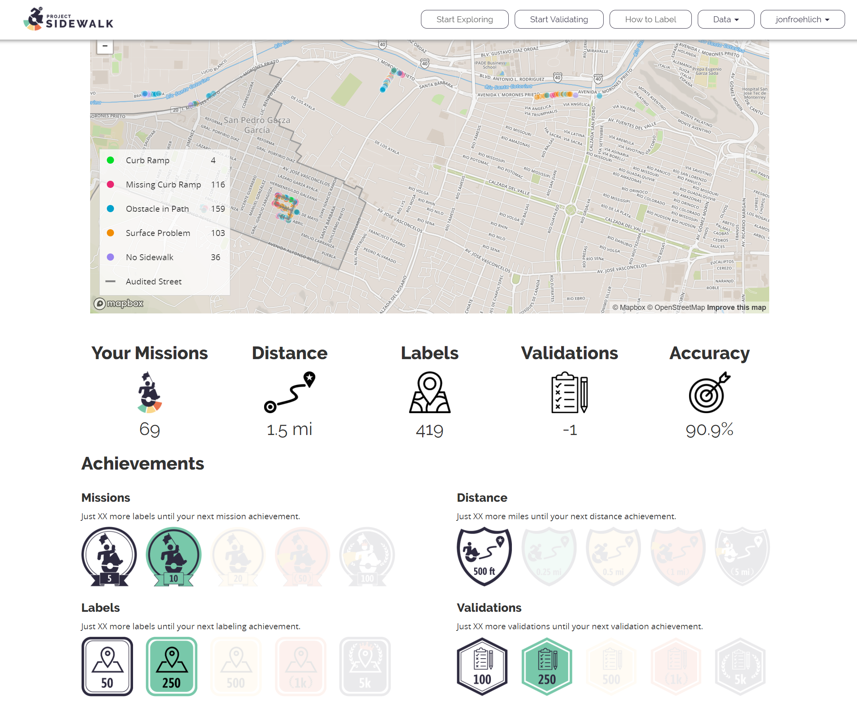
Current Mission
Validate 10 labels
50%
Achievements
Validations
21%
Missions
67%
Correct Labels

Slide 10
Current Mission
Validate 10 labels
50%
Achievements
Validations
21%
Missions
21%
Correct Labels

Slide 11



Current Mission
Validate 10 labels
50%
Badge Progress
Validations: 122/200
21%
Missions: 12/20
9%
Rank
Missions
Validations
8th
3rd
Correct Labels

Slide 12
Current Mission
Validate 10 labels
50%
Achievements
Validations: 122/200
21%
Missions: 12/20
9%
Rank
Missions
Validations
8th
3rd
Correct Labels

Slide 13
Current Mission
Validate 10 labels
50%
Achievements
Validations: 122/200
21%
Missions: 12/20
9%
Validations
Missions
3rd
8th
Correct Labels
Rank

